Slide 1

Graduate Studies Workshop
Part 1
Social Welfare and
Social Development

Slide 2

1. What is a Master’s Degree?

Slide 3
Differences from Undergraduate Studies
Fewer courses each semester
Much more reading and writing
You choose classes, professors, supervisors, and committees
Notes:
All aspects of graduate programs, from application to completion, assume that you take the initiative.

Slide 4
Types of Programmes
Format 1: Coursework only
Format 2: Coursework plus Major Research Paper (MRP)
Format 3: Coursework plus Master’s Thesis
Some MA degrees take two years to complete
Most MA degrees take only one year (or slightly more) to complete

Slide 5


Slide 6
Getting Ready to Apply for an MA
You should decide which programs you want to apply to during the summer following your third year of undergraduate studies
MA applications and scholarship applications are due early in the autumn.
Please give your professors at least two weeks to prepare your letters of reference.

Slide 7

2. Why Should You Do an MA?

Slide 8
Why Should You Do an MA?
Financial advantage (earn more money): Canada 2005-2009 (Statistics Canada)
Better job opportunities, future promotion
Lower unemployment rate
Shows you are dedicated enough to set your sights on a tough goal and attain it.
College graduate | Bachelor | Master’s | Doctoral
$35,000 | $45,000 | $60,000 | $65,000
Notes:
- Can get university funding to do an MA ($2000-$10,000/year)

Slide 9

3. How Can I Afford to Do This?

Slide 10
How Can I Afford to Do This?
You can get scholarship funding to do an MA
You may also pay for your MA by becoming a research assistant or a teacher assistant

Slide 11
Government of Canada Funding
  The Canada Graduate Scholarships Master’s Program (CGS M) supports 2,500 students every year.
  http://www.nserc-crsng.gc.ca/Students-Etudiants/CGSHarmonization-HarmonizationBESC_eng.asp
Qualifying Canadian universities receive a CGS M allocation (i.e. a number of students to whom they can award scholarships)
Allocations are divided by broad fields of study: 1) health, 2) natural sciences and/or 3) engineering and 4) social sciences and/or humanities

Slide 12
Ontario Graduate Scholarships (OGS)
https://osap.gov.on.ca/OSAPPortal/en/A-ZListofAid/PRDR013089.html

Slide 13
Ontario Graduate Scholarships (OGS)
1) Each university gives awards individually and sets their own deadlines
2) Apply for an OGS at each of the universities you are interested in attending
3) The Graduate Studies Offices at eligible Ontario universities are responsible for administering the OGS Program

Slide 14
University Funding
University & Programme Scholarships
Teaching Assistantships
Research Assistantships
Notes:
**INSERT SAMPLE OF A TYPICAL PACKAGE

Slide 15
Typical Funding Package (1)
University of Windsor Master’s (2014)
One year (3 semesters):
  Graduate Entrance Scholarship: $3,500
    NOTE: Must maintain a high academic average (above 80%, or equivalent)
  Graduate Assistantships: $9,500
    Maximum 10 hours per week of work
    Total = $12,500
Notes:
NOTE: Can also add:
Research Assistantships, at $15-25/hour, for a max of 10 hours a week
Travel bursaries
Other external funding would trump the scholarships… eg. SSHRC etc.

Slide 16
Typical Funding Package (2)
UBC Sociology (2013-14)
Year 1:
  Graduate Entrance Scholarship of $10,000
  TA position (max $11,400)
  Total = $21,400
Year 2:
  Graduate Scholarship of $5,000
  TA position (max $11,400)
  Total = $16,400

Slide 17
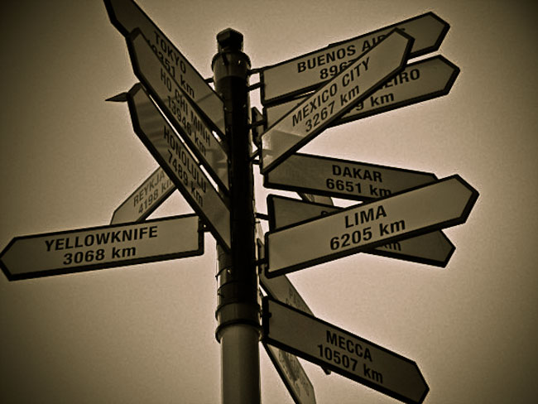
4. Where Should I Go?
www.nipissingu.ca/socialwelfare/MAprograms

Slide 18

5. Graduate Studies Workshop
Part 2

Slide 19
Graduate Studies Workshop
Part 2
The following topics will be covered:
    The Application Process
    Statement of Purpose
    Letters of Reference
    Sample of Written Work

Slide 20
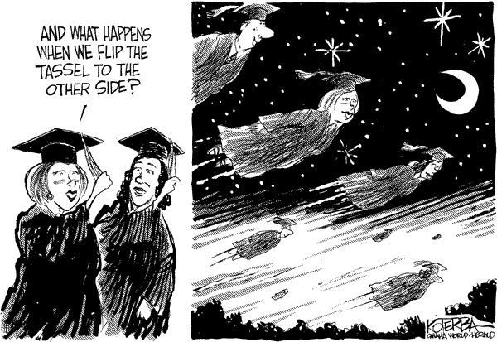
Good Luck!

